Slide 1
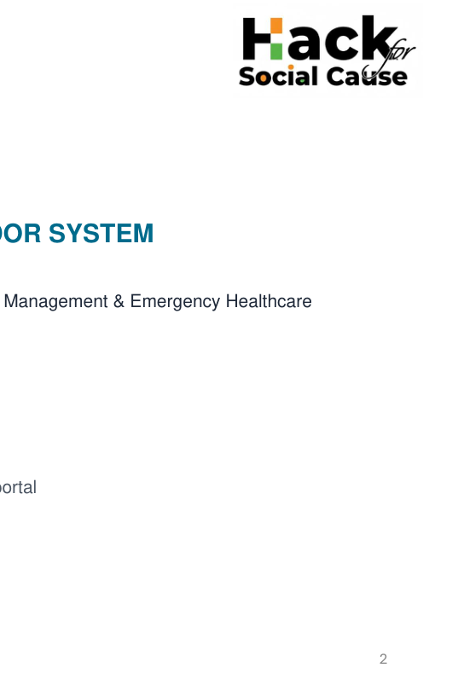
TEAM
NEXUS
TEAM NEXUS
SMART EMERGENCY GREEN CORRIDOR SYSTEM
Hack for Social Cause – 2027
Theme: Smart Transportation, Intelligent Traffic Management & Emergency Healthcare
TEAM NEXUS
Team Leader: KUMARAGURU M
Members: ADIDEV M | GOKUL RAJ PS
Tamil Nadu | Team ID: HSC|TN|02460

Slide 2
PROBLEM – PROPOSED SOLUTION
TEAM
NEXUS
THE PROBLEM
OUR SOLUTION
• Severe Golden Hour Delays: Ambulances lose critical life-saving minutes trapped in dense urban traffic, mid-lane queues, and uncoordinated red signals.
• Flaws in Legacy Tech (RFID & AI Cameras): Traditional RFID systems lack cryptographic security and are easily cloned/spoofed, while existing AI Camera-based systems are prohibitively expensive, suffer from poor visibility/occlusion (blocked by heavy vehicles, rain, or night glare), and only detect ambulances at short line-of-sight distances rather than clearing traffic 1 km in advance.
• Blind Spots & Multi-Ambulance Clashes: No signal intersections lack automated traffic clearance, and simultaneous approaches by multiple ambulances at a single junction create gridlock.
• Hospital Unpreparedness: Destination hospitals receive minimal advance notice regarding incoming patient severity, delaying emergency room (ER) mobilization.
• The "Unidentified Victim" Crisis: Unconscious accident victims (especially elderly individuals, migrants, or solo commuters) without physical IDs or with biometric-locked smartphones (where Face ID/Fingerprint fail due to closed eyes or weak pulse) cannot be identified—stalling family notification, medical consent, and critical care decisions.
• 3-Tier Role-Based Ecosystem: Dedicated, secure portals for Government Command (city-wide tracking & signal override), Hospitals (approaching ambulance alerts & patient vitals), and Ambulance Drivers (live congestion routing & hospital selection).
• 1 km Predictive Green Corridor: Combines onboard GPS tracking with ML-based route and congestion prediction to automatically trigger green signals 1 km ahead of the ambulance, restoring normal signal cycles immediately after passage.
• Smart Roadside Beacons & Triage Priority: Deploys LoRa-enabled roadside beacons for un-signaled zones and uses an automated Triage Priority Algorithm (Red/Yellow/Green severity) to resolve multi-ambulance junction conflicts.
• Dynamic Hospital Routing & Pre-Arrival Sync: Recommends the fastest nearby hospital (with options for family-preferred overrides) and transmits prior arrival alerts to prepare trauma teams in advance.
• 108 Emergency Reverse-Tracing: Utilizes authorized telecom/government API integration to trace incoming emergency calls from locked devices, identifying unconscious victims and automatically notifying linked family members or frequent contacts via recent call logs.
@HSC submission – Template | HYDRIX
2

Slide 3
TEAM
NEXUS
TECHNICAL APPROACH
TECH STACK
Hardware & Edge: ESP32 Microcontroller, NEO-6M GPS Module, SX1276 LoRa Transceiver (for zero-cellular P2P signal pre-emption and roadside beacons).
Application & Mapping: Flutter (Cross-platform Role-Based App for Govt, Hospital, and Driver), Google Maps API with ML traffic-congestion routing
Cloud & Communication: Firebase Realtime Database, MQTT Broker for ultra-low-latency (<200 ms) signal relay, and Authorized Telecom API (for 108 reverse-call tracing).
Vision AI & Triage Engine: Already Roadside CCTV installed places will be integrated with YOLOv8 for real-time vehicle-queue density estimation and automated multi-ambulance conflict resolution.
IMPLEMENTATION FLOW
1. VERIFY
2. ROUTE
3. TRACK
4. PREDICT
5. PRIORITIZE
6. ALERT
Role-based login (Govt / Hospital / Driver) + cryptographically verified Ambulance ID.
→
ML selects least-congested route & target hospital; paramedic logs patient triage severity.
→
Live GPS telemetry to cloud + 108 Reverse-Trace triggers automated family alert for unidentified victims
→
Geofencing calculates junction ETA & detects queue density 1 km ahead of the ambulance.
→
Triggers green signal 1 km ahead (or activates roadside beacons); resolves multi-ambulance clashes via triage rank.
→
Dispatches pre-arrival ER alert to destination hospital and resets traffic signal to normal post-passage.
SECURITY
• Strict Role-Based Access Control (RBAC): Partitioned privileges ensuring drivers only control active route signals, hospitals only view incoming patient data, and Government retains master oversight.
• Anti-Spoofing & Privacy Protection: AES-128 payload encryption, GPS heading/vector verification (preventing parallel-road false triggers), and automated Zero-Knowledge IVR alerts to notify victim families without exposing private call logs.
AI: YOLOv8 queue detection. Add GitHub and demo-video links when available. Validate latency and reliability through testing.
@HSC submission – Template | HYDRIX
3

Slide 4
IMPACT POTENTIAL
TEAM
NEXUS
CRITICAL PATIENTS
AMBULANCE DRIVERS
Drastically cuts intersection wait times during the Golden Hour and ensures seamless post-admission care by rapidly connecting family members/attenders for unidentified victims.
Provides stress-free navigation with automated 1 km advance green corridors, dynamic congestion bypass, and effortless hospital switching.
HOSPITALS
TRAFFIC POLICE
Delivers real-time incoming ambulance tracking, advance triage alerts to mobilize ER staff/beds, and immediate family contact verification for critical medical consents.
Offers a centralized command dashboard with automated conflict resolution, reducing manual traffic-clearing burdens in un-policed or congested zones.
SOCIAL BENEFIT
ECONOMIC + ENVIRONMENTAL
Bridges the emergency care gap for vulnerable groups (elderly citizens, out-of-station students/workers) by ensuring no patient remains "unidentified" or unattended in government/private hospitals.
Retrofits into existing traffic infrastructure using low-cost IoT modules; prevents severe junction gridlocks and reduces fuel wastage and emissions from idling vehicles
@HSC submission – Template | HYDRIX
4

Slide 5
TEAM
NEXUS
FEASIBILITY AND RISK ANALYSIS
FEASIBILITY
RISKS / CHALLENGES
MITIGATION
• Cost-Effective Hardware: Built on affordable, off-the-shelf ESP32, NEO-6M GPS, and SX1276 LoRa modules for scalable deployment.
• Network-Independent Fallback: LoRa P2P communication ensures reliable 1 km signal pre-emption and beacon activation even during cellular network blackouts.
• Modular Software Integration: Role-based Flutter architecture easily integrates with existing Smart City (ICCC) dashboards and 108 emergency response systems.
• Signal Spoofing / Hacking: Unauthorized users attempting to trigger green lights (common in legacy RFID systems).
Multi-Ambulance & Parallel Road Conflicts: Two ambulances approaching the same junction simultaneously, or GPS drift triggering signals on adjacent roads.
• Un-Signaled Congestion Zones: Bottlenecks at intersections lacking traffic lights or traffic police personnel.
• Privacy & Regulatory Compliance: Securing authority approval for live traffic signal control and telecom-based emergency caller tracing.
• Cryptographic Authentication: Enforces AES-128 encryption, signed MQTT packets, and whitelisted hardware IDs to eliminate spoofing.
Vector Geofencing & Triage Priority: Uses GPS heading checks to confirm route alignment and prioritizes higher-severity (Red Triage) ambulances during junction conflicts.
Smart Roadside Beacons: Deploys solar-powered LoRa warning beacons at no -signal bottlenecks to alert commuters ahead of time.
Fail-Safe Governance: Maintains mandatory pedestrian clearance timers, override controls, and automated privacy-masked family notifications via official 108 gateways.
INNOVATION & UNIQUENESS
• Spoof-Proof Architecture: Replaces vulnerable RFID triggers with AES-128 encrypted GPS telemetry, registered device IDs, and cryptographically signed priority requests.
• End-to-End Life-Saving Continuum: Goes beyond road transit by solving post-arrival hospital bottlenecks through automated next-of-kin tracing for unidentified trauma patients.
<200 ms latency and zero recurring cost are design targets to validate, not measured results.
@HSC submission – Template | HYDRIX
5

Slide 6
TEAM
NEXUS
TEAM
TEAM COMPOSITION — TEAM NEXUS
KUMARAGURU M
Team Leader | Core Member | Embedded Systems & IoT Hardware: Develops the onboard ESP32-GPS telemetry unit, SX1276 LoRa 1 km signal pre-emption module, and smart roadside beacon hardware.
ADIDEV M
Member | System Architecture, AI/ML & Integration: Leads overall system architecture, ML route/congestion modeling, 3-tier role-based workflow design, and presentation strategy.
GOKUL RAJ PS
Member | Application Development, Testing & Documentation: Builds the Flutter role-based interfaces (Govt, Hospital, Driver), Firebase/MQTT cloud integration, and system validation.
Journey focus: build a safe, low-cost prototype; validate with simulated traffic before field trials.
@HSC submission – Template | HYDRIX
6

Slide 7
REFERENCES
TEAM
NEXUS
• Ministry of Road Transport & Highways (MoRTH) – Golden Hour & Good Samaritan Guidelines: https://morth.nic.in/
https://morth.nic.in/
• Telecom Regulatory Authority of India (TRAI) – Next-Gen Emergency Communication Frameworks: https://www.trai.gov.in/
https://www.trai.gov.in/
• Flutter documentation: https://docs.flutter.dev/
• Google Maps Platform: https://developers.google.com/maps
• Espressif ESP32 documentation: https://docs.espressif.com/
• u-blox GPS receiver documentation: https://www.u-blox.com/
• LoRa / SX1276 datasheet and Semtech documentation: https://www.semtech.com/
• MoHUA Smart Cities / ICCC resources: https://mohua.gov.in/
Research Scope: 1 km predictive signal pre-emption, role-based emergency governance, AI queue-density estimation, multi-ambulance triage prioritization, and automated next-of-kin tracing for unidentified trauma victims.
Prototype status: simulated-data concept; performance and real-world outcomes remain to be validated.
@HSC submission – Template | HYDRIX
7

